Slide 1
Introducing to SVC Solution
Yang Songhua
April-24-2016

Slide 2
Agenda
General Video knowledge
Scalable Video Coding
AVC
MRC Overview
MRC Media – Audio
MRC Media – Uplink Video
MRC Media – Downlink Video(Layout)
MRC Media – Media Quality

Slide 3
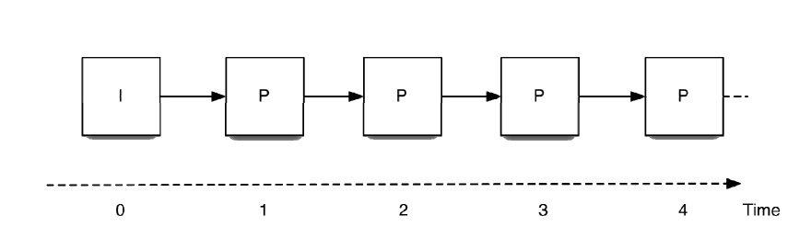
General Video Knowledge
RGB/YUV/H264/RTP
720P 30fps
YUV raw data 1280*720*1.5*30*8=331776 kbit
H264: 768kbps
331776/768=432

Slide 4
SVC(Scalable Video Coding)
SVC is an adaptive, bandwidth-efficient technology that delivers a consistently high-quality user experience across network with varying degrees of quality of service.
Video endpoints are required to become more complex
Video infrastructure becomes simpler.

Slide 5
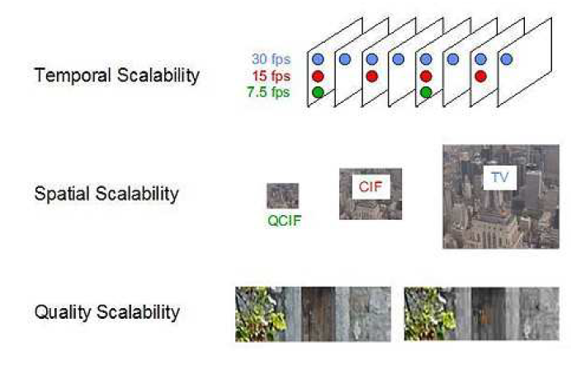
SVC defines 3 modes of scalability

Slide 6
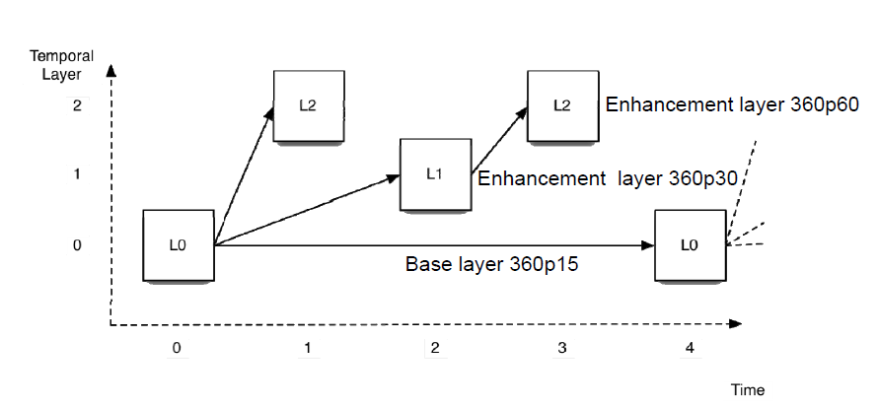
SVC Temporal Scalability

Slide 7
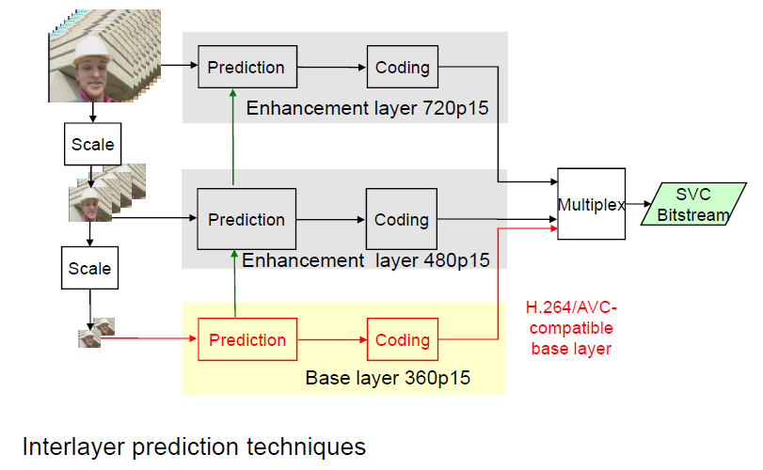
SVC Spatial Scalability

Slide 8
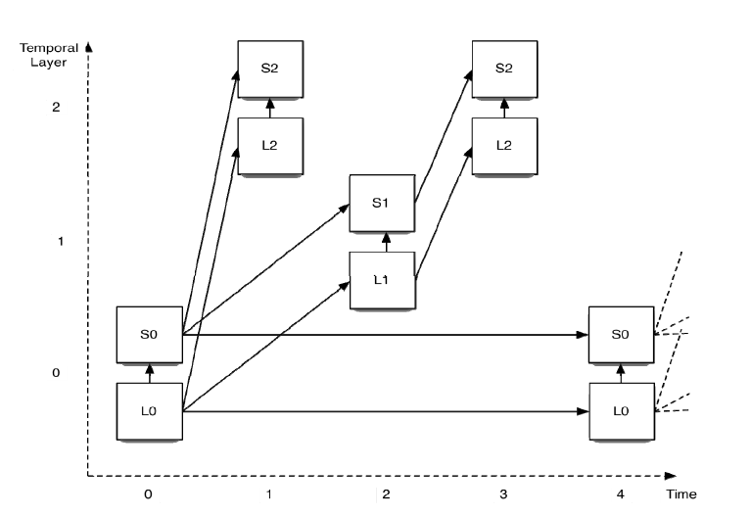
SVC: Combining Temporal and Spatial Scalability

Slide 9
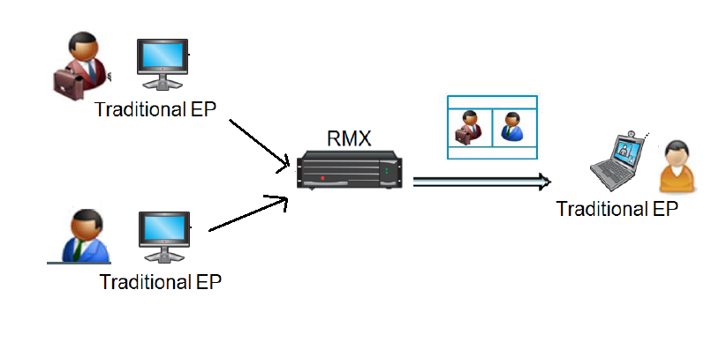
AVC

Slide 10
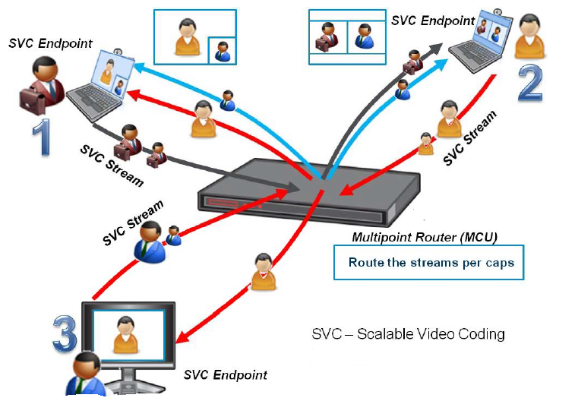
MRC Overview

Slide 11
MRC Overview
MRM does almost no media processing.
MRM is not aware of layouts, only of the streams selected by the MRE.
The streams are selected by MRM based on audio energies, active speaker history, link bandwidth and quality and endpoints preferences.
MRE performs themselves the audio mixing and layout building.

Slide 12
H.264 SVC Benefits
Simplification and cost reduction in multipoint video conferencing hardware
Lower latency and higher interactivity on multipoint video
Video calls between endpoints with widely varying processor power and network performance characteristics
Brings video closer to “cloud computing”
Improve the resilience against packet loss
SVC Router is simply an application layer router
Near zero-delay
Eliminates video quality loss due to transcoding
Extremely low cost of computer power
Limiting parameter is network I/O bandwidth and not number of video streams or resolution

Slide 13
H.264 SVC Drawbacks
All EPs must support the protocol or they will not be able to join
Each call has minimum BW requirement, and EPs not supporting it will not be able to join
No standard for signaling in SVC networks
Different SVC codec cannot currently communicate with each other.

Slide 14
MRC Media – Audio
Only the SAC codec is used per that conference.
MRDs not supporting SAC are not admitted to the conference.
MRM does not do transcoding and/or audio mixing.

Slide 15
MRC Media - SAC
MRC uses a scalable version of Siren LPR
The VAD (Voice Activity Detection bit) and energy are carried in the RTP header.
Audio Scalability:
10K
10K
10K
48K
10K
38K
48K
Uplink (MRE to MRM)
Downlink (MRM to MRE)

Slide 16
MRC Media – SAC Error Resiliency
Redundant packets are per link.
The receiving entity indicates the transmitting entity the redundant packets number by RTCP feedback message.
The redundant packets contain a 10K bitrate trimmed payloads of the packets transmitted at t-2, t-4, t-6 and t-8 - depending on the requested number of redundant packets.
Trimming the packet from 48K to 10K does not require meaningful processing.
Redundant packets are only for the most active speaker.
For stereo SAC, the transmitting endpoint sends redundant packets for both the left and right streams.
MRM handles the audio LPR without adding latency.

Slide 17
MRC Media – Uplink Video
For Quality and spatial scalability, there are two possible modes:
ILP – Inter Layer Prediction --- dependant spatial layers
Simulcast – independent spatial layers
RPD: 180P, 360P, 720P
three encoders, one RTP session

Slide 18
MRC Media – Layout
MRE uses SCP messages to indicate to MRM which media streams it wants.
MRM is not aware of layouts, only of the streams selected by the MRE.
Active Speaker Change
Auto mode
Manual mode
Forced mode

Slide 19
MRC Media – Layout of RPM iOS
UI
Layout engine
Video Dec1
Render 1
View 1
Video
RTP Recv
Layout guide
Video Dec2
Render 2
View 2
Video Dec3
Render 3
View 3
Video Dec4
Render 4
View 4

Slide 20
MRC Media – Media Quality
Video Error concealment mechanism
Video Retransmission
GDR vs. IDR
Video Jitter buffer
AV Sync

Slide 21
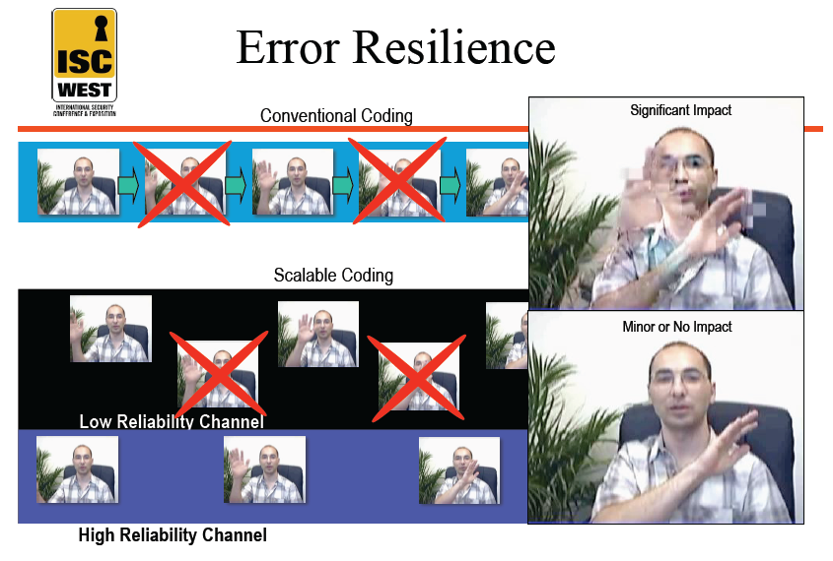

Slide 22
Media Quality– Error concealment mechanism
Video retransmission is used to protect critical packets
Video retransmission is per link
The receiving entity, identify a lost critical packet and request the sender (via RTCP) to re-transmit it
If a critical packet is lost (and a replacement has not been received on time), a request (through RTCP) is made to the sender to insert a refresh frame (IDR, GDR)

Slide 23
Media Quality– GDR and IDR
IDR: Instantaneous decoder refresh
Refers to “clean” random access, where no data prior to an intra frame is referred to in the decoding process.
An IDR picture signals the start of a new independent GOP(group of pictures).
GDR: Gradual Decoder Refresh
refers to “dirty” random access, where previously coded but possibly non-received data is referred and correct picture content is recovered gradually in more than one coded pictures.

Slide 24
Media Quality– typical GDR Patterns
Gradual random access by using isolated regions
– wipe down refresh pattern

Slide 25
Media Quality– GDR vs. IDR
a decoder refresh has 3 main requirements:
Bring the decoder to be synchronized with the stream and its output must be clear from artifacts.
both IDR & GDR fulfill the requirement
Minimize the Video quality degradation that derives from the need to refresh (same average bitrate must be maintained)
the degradation in Video quality (PSNR) in case of IDR is more than the degradation in case of GDR
In cases of “stream sharing” in which several decoders receive the same stream – the refresh affect should be minimal to other endpoints (not needing the refresh)
GDR has much less undesired effect

Slide 26
Media Quality– GDR vs. IDR
It takes 1xGDR length to 2xGDR lengths to see the video when a participant joins in a conference.
When a participant joins, a GDR is created for him/her. If another user joins after the GDR has already started, another GDR will be requested.
Video freeze longer if GDR has been requested because of lost T0(rex is also lost).
It takes encoder GDR length to generate a GDR sequence.

Slide 27
Media Quality– Jitter Buffer
Decoder Jitter Buffer
Render Jitter Buffer

Slide 28
Media Quality– AV Sync
Use of timestamps for synchronized AV playback at the receiving EP
RTCP is used to monitor the network latency on each Media connection, and evaluate the WC differences.
MRM is using one wall-clock for all RTP packets it sends on the downlink
Do not require the EPs to sync to an NTP server (have the same wall clock), but we should be able to detect such case and set a Wall clock diff accordingly

Slide 29
Media Quality– AV Sync
sync the audio and video from the same source by the timestamp and NTP time in RTCP packets
If video is behind audio more than 90ms, it should play faster and smoothly to catch up.
If video is ahead audio more than 90ms, it should play slower or freeze to wait audio.
The latency depends on audio’s latency.

Slide 30


